Slide 1
Query Store on-Prem
and in the Cloud
Deepthi Goguri

Slide 2





Deepthi Goguri
Masters in Computer Technology
MCT/MCSE
Organizer for DEI user group and AI South Florida user group
WIT Volunteer
Love Arts and Crafts
She/Her
@dbanuggets
https://www.linkedin.com/in/deepthigoguri/
https://dbanuggets.com/

Slide 3

What are we going to cover?
Introduction
Query Store benefits
Plan forcing
Failures
Automatic plan correction
Query Store hints (Preview)

Slide 4

Introduction

Slide 5

What is Query store?
Introduced in SQL Server 2016
Captures history of query plans
Option to choose optimal plan
Database level option only
Disabled by default
SQL Server and Azure Synapse Analytics database
Enabled by default (Azure SQL database)
Cannot be enabled on master or tempdb

Slide 6

How Query Store works?

Slide 7
Query
Are you running for the first time?
YES
NO
Compilation and Optimization
Plan in Cache?
NO
YES
Is this plan the same forced plan?
But wait, check for recompilation!
Alright, then take it from the plan cache!
CHECK
Oops, NO!
YES
1. Async
Query Text
Query Plan
Async
Plan Store
Query Store
Schema
Apply the forced plan
2. Run
In-Memory
Async
Query Executes
Async
Run time Stats
Runtime stats Store

Slide 8
Plan cache vs Query Store
Plan cache
Flushed out on every server restart
Stores latest plans
Evicted on memory pressure
Difficult to know why plan changed
Query Store
Retains the data (CLEANUP_POLICY)
Collects plans over time
Flush out intervals
Useful when troubleshooting performance problems

Slide 9

What data is collected?
SQL Server 2017+ includes wait stats information
CPU, IO, Memory
Duration, Logical Reads and Writes, Physical Reads, CLR Time, DOP, Row Count, Log Memory Used, Temp DB Memory Used, and Wait Time
History of the plans
Resource-consuming queries

Slide 10
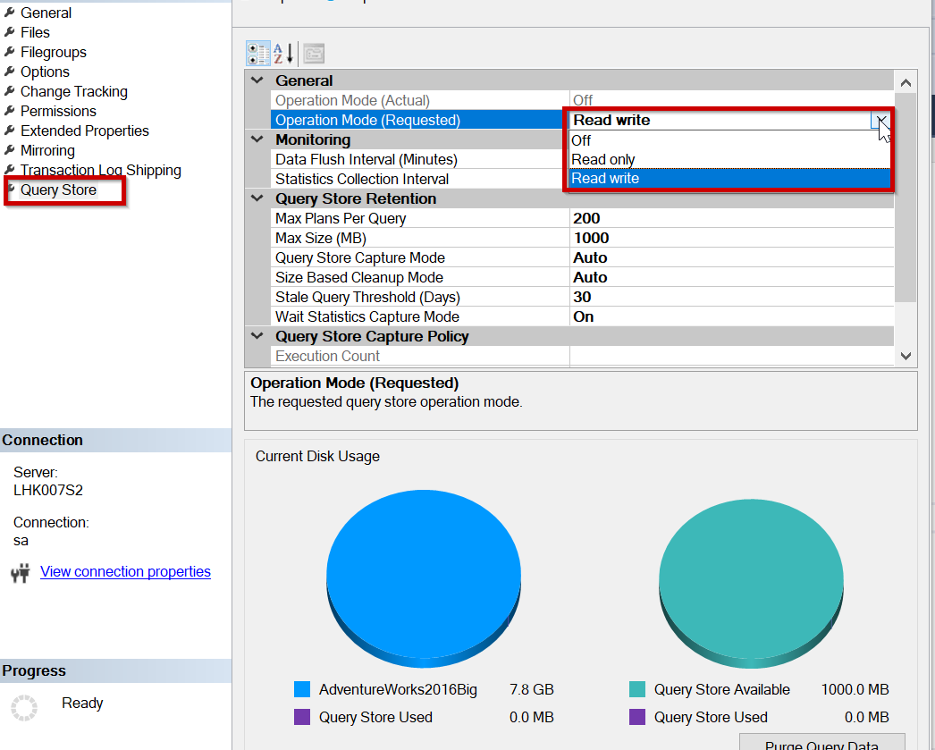
Query Store Operation Mode

Slide 11
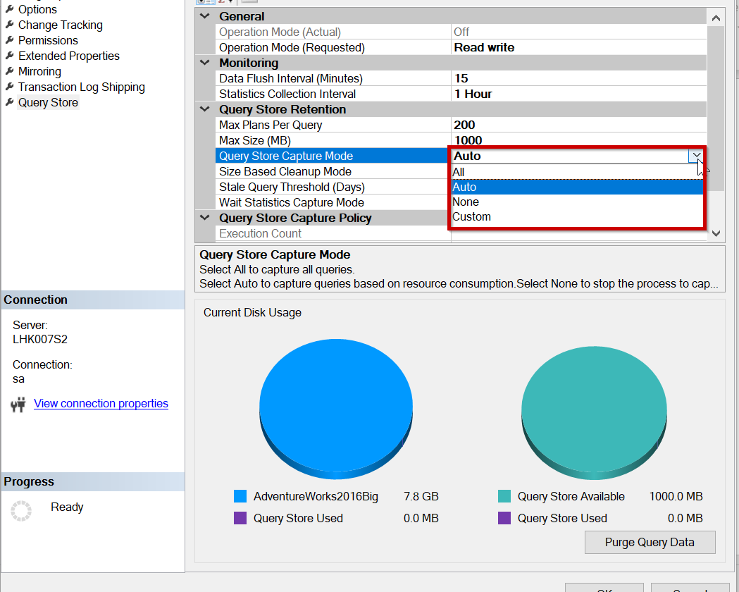
Query Store Capture Mode

Slide 12

Query Store options

Slide 13

CLEANUP_POLICY – 30 days by default
DATA_FLUSH_INTERVAL_SECONDS – 15min by default
MAX_STORAGE_SIZE_MB
100MB default (SQL Server 2016/2017)
1GB (SQL Server 2019)
For a complete list of options:https://docs.microsoft.com/sql/t-sql/statements/alter-database-transact-sql-set-options

Slide 14

Query Store benefits

Slide 15

Query Store benefits
Identify regressions due to plan changes
Quickly fixes non-optimal plan usage
Performance tuning
No changes needed to user applications or underlying code
Useful during the database upgrades

Slide 16

Three stores
Plan store
Run-time stats store
Wait stats store

Slide 17
Catalog views
Query related
sys.query_store_query_text
sys.query_context_settings
sys.query_store_query
sys.query_store_plan
Stats related
sys.query_store_runtime_stats
sys.query_store_wait_stats
sys.query_store_runtime_stats_interval
https://docs.microsoft.com/sql/relational-databases/system-catalog-views/query-store-catalog-views-transact-sql

Slide 18
Stored procedures
Remove plan/query
sp_query_store_remove_query
sp_query_store_remove_query
Force/unforce plan
sp_query_store_force_plan
sp_query_store_unforce_plan
Others
sp_query_store_flush_db
sp_query_store_reset_exec_stats
sp_query_store_set_hints
https://docs.microsoft.com/sql/relational-databases/system-stored-procedures/query-store-stored-procedures-transact-sql

Slide 19

Plan forcing

Slide 20

Plan forcing
Just like the USE PLAN query hint
Optimizer uses the forced plan
If it fails, optimize in the regular way
Force using sp_query_store_force_plan
Unforce using sp_query_store_unforce_plan

Slide 21

Failures

Slide 22

Monitoring failures
Objects used in the forced plans are altered or dropped
Can cause NO_PLAN, NO_INDEX failure reasons

Slide 23

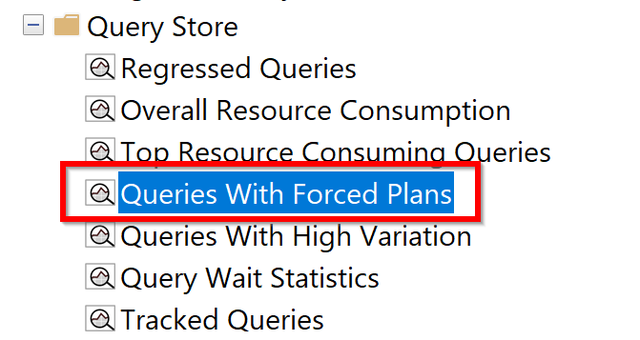
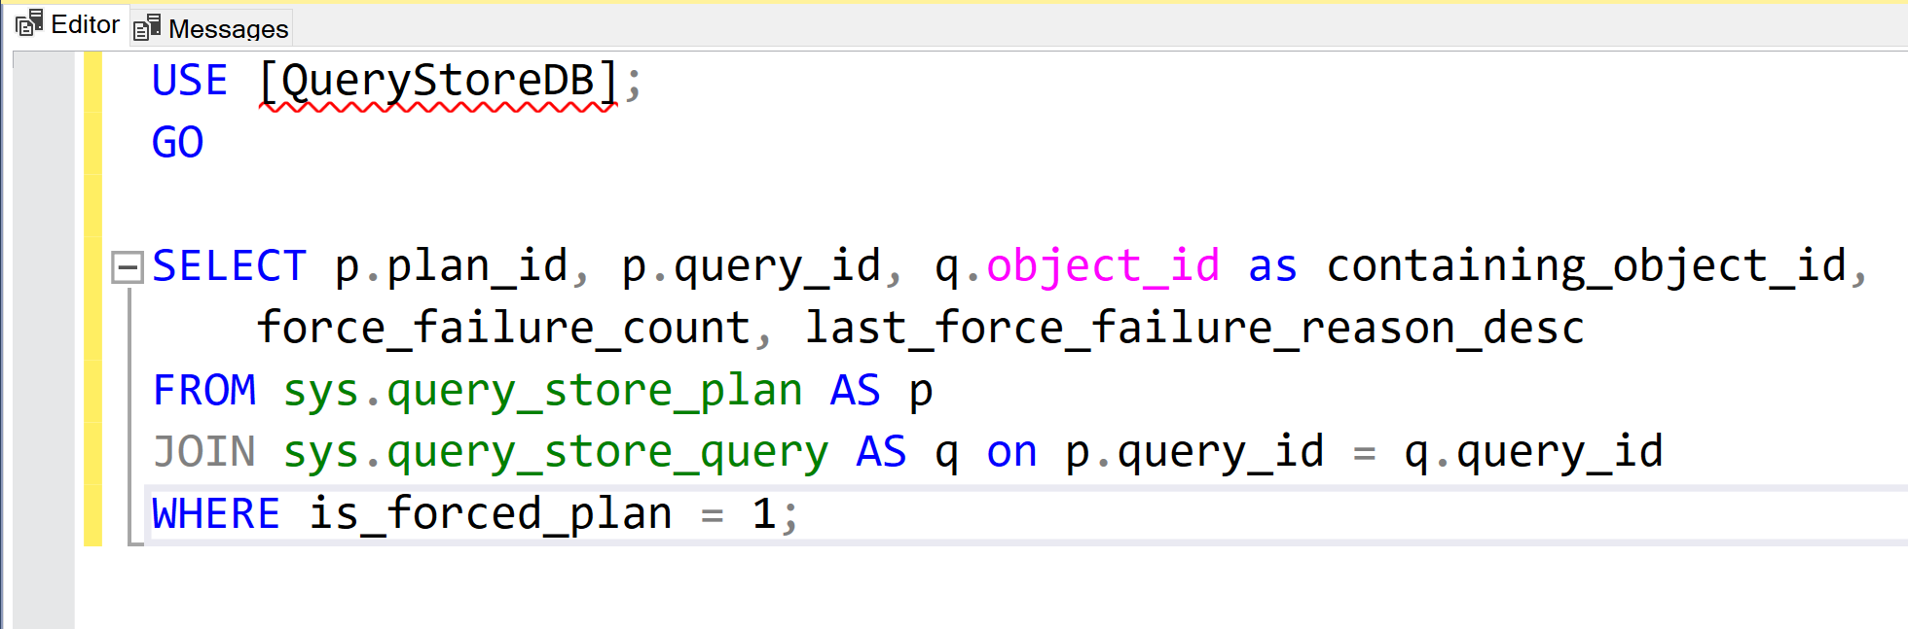
Monitoring failures
Monitor using Query Store GUI in SQL Server Management Studio, or by using catalog views
https://docs.microsoft.com/sql/relational-databases/performance/best-practice-with-the-query-store

Slide 24

Automatic plan correction

Slide 25

Automatic plan correction
SQL Server 2017 and above
Continuous monitoring for plan regression
Adjust accordingly by forcing/unforcing
Enable using T-SQL or using the Azure portal
T-SQL
ALTER DATABASE Databasename
SET AUTOMATIC_TUNING (FORCE_LAST_GOOD_PLAN = ON );
sys.dm_db_tuning_recommendations

Slide 26
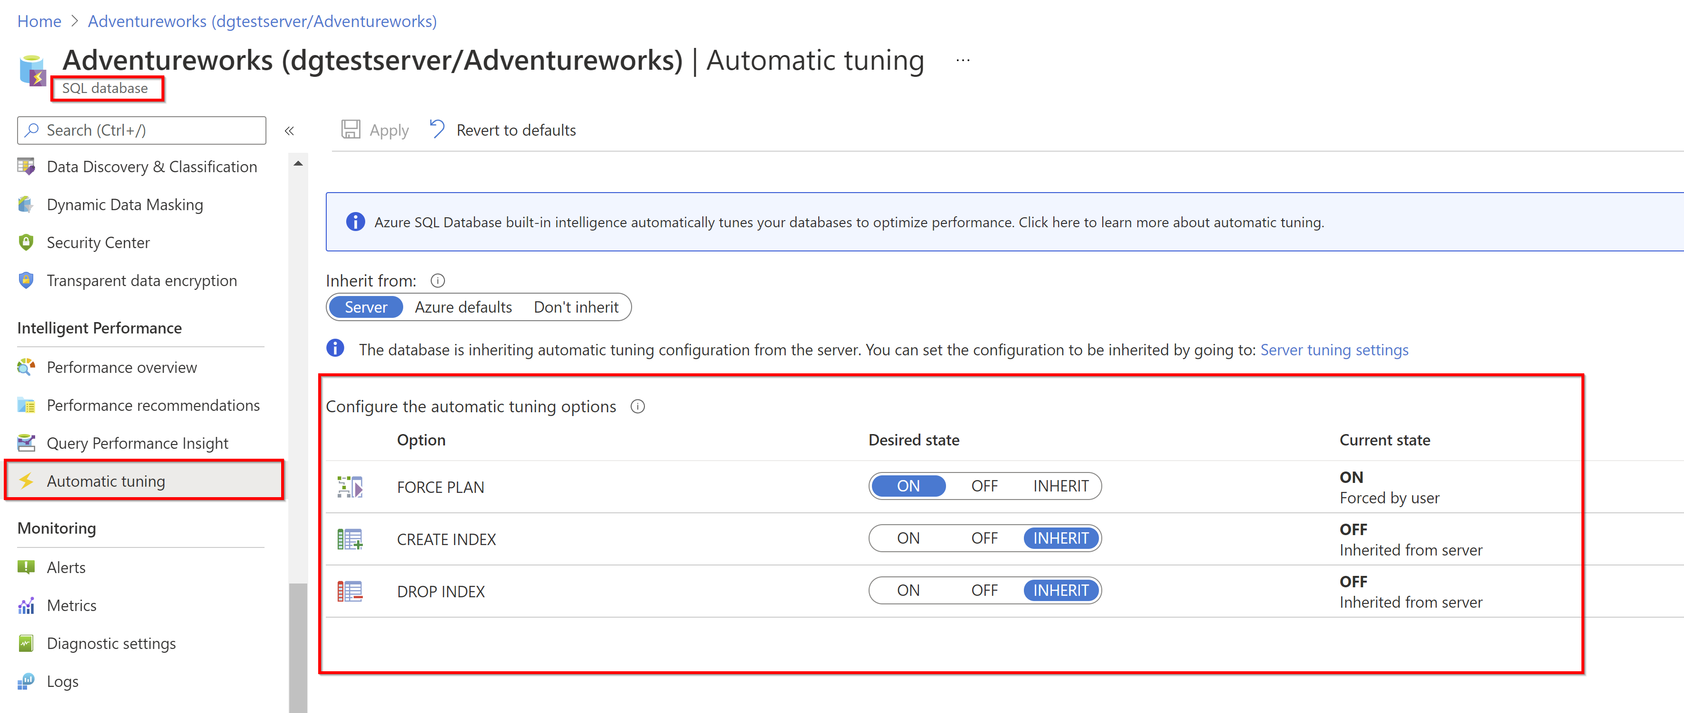
Azure portal: Enable FORCE PLAN

Slide 27


Query Store hints
MAXDOP
RECOMPILE
COMPAT LEVEL?
MAX_GRANT_PERCENT

Slide 28

Query Store hints (preview)
Available for preview in Azure SQL database
Azure SQL databases, elastic pools, managed instances, and hyperscale databases
Used for optimizing specific queries under specific conditions
Simple to fix without modifying underlining code
Query hints like MAXDOP, recompile, max/min memory grant size, compatibility level, etc.

Slide 29

Using Query store hints
Get the query_id from catalog views
Stored procedure sp_query_store_set_hints
Example:
EXEC sp_query_store_set_hints @query_id=5, @value = N'OPTION(RECOMPILE)';

Slide 30

DEMO

Slide 31
Takeaways (1/4)
Cannot be disabled in Azure SQL Database single database and Elastic Pool
TF 7745 to avoid writing QS data to disk before SQL Server shutdown
TF 7752 enables asynchronous load of Query Store (default in SQL Server 2019)
Source: https://docs.microsoft.com/sql/relational-databases/performance/best-practice-with-the-query-store

Slide 32
Takeaways (2/4)
Natively compiled queries runtime stats
Enable sys.sp_xtp_control_query_exec_stats (not persisted, configure on every sql server restart)
If many unique ad-hoc queries, use Optimize for Ad hoc Workloads option to save cache memory
Source: https://docs.microsoft.com/sql/relational-databases/performance/monitoring-performance-by-using-the-query-store
https://docs.microsoft.com/sql/relational-databases/performance/best-practice-with-the-query-store

Slide 33
Takeaways (3/4)
Max plans per query is set as 200 execution plans per query by default
If MAX_STORAGE_SIZE_MB is reached, Query Store goes into read-only mode
Size Based Cleanup Mode to avoid changing to read only mode once max size is reached (90 percent of max_storage_size_mb)
Source: https://docs.microsoft.com/sql/relational-databases/system-catalog-views/sys-database-query-store-options-transact-sql
https://docs.microsoft.com/sql/relational-databases/performance/best-practice-with-the-query-store
https://docs.microsoft.com/sql/relational-databases/system-catalog-views/sys-database-query-store-options-transact-sql

Slide 34
Takeaways (4/4)
Auto mode (avoids ad-hoc queries with small resource consumption)
QS QUERY_CAPTURE_MODE to AUTO is recommended (Default in Azure SQL Database,SQL Server 2019)
Source: https://docs.microsoft.com/sql/relational-databases/performance/best-practice-with-the-query-store

Slide 35

Useful Query Store Queries on Github
https://github.com/channeladvisor/qdstoolbox

Slide 36
Performance overload questions?
https://www.sqlskills.com/blogs/erin/query-store-performance-updated/

Slide 37

Learn more..
Best practices:
https://docs.microsoft.com/sql/relational-databases/performance/best-practice-with-the-query-store
https://dbanuggets.com/category/query-store/

Slide 38

Resources
https://docs.microsoft.com/en-us/sql/relational-databases/performance/monitoring-performance-by-using-the-query-store?view=sql-server-ver15
https://docs.microsoft.com/en-us/sql/relational-databases/performance/best-practice-with-the-query-store?view=sql-server-ver15
Pictures resource: https://www.pexels.com/

Slide 39

Thank you!

